Slide 1
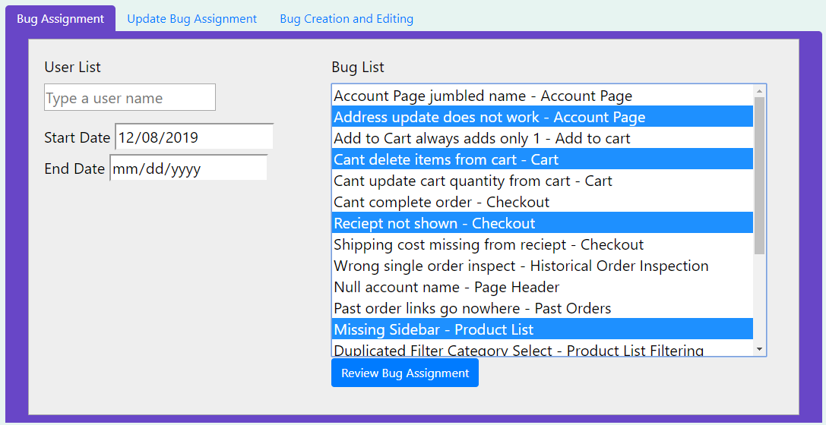
Bugs are Features Too
Customer: Trissential - Software QA
Goal: Create a mock e-commerce website with the ability to assign intentional bugs to specific users.
Purpose: To provide our customer a platform to train and evaluate their Software QA skills. Also, to allow them to demonstrate their services to prospective clients in a neutral environment they can control.
Seanna Lea LoBue, Michael Murray, Eric Prewitt, Nicholas Wade, Kee West

